Slide 1
MongoDB
Sonali Ma’am

Slide 2
Two of the most commonly used database types are SQL databases (e.g., relational databases) and NoSQL databases.
What is NoSQL?
which stands for Not only SQL, is a database management system approach used to ingest, store, and retrieve unstructured data and semi-structured data within a database.
The reason it is called NoSQL is to emphasize that these databases can handle non-tabular, non-relational data

Slide 3
What is unstructured data?
Unstructured data is data that doesn't have a predefined data model or consistent organization. In addition, unstructured data, such as social media posts, can update and change rapidly while structured data, such as bank transactions, have a much lower rate of change.

Slide 4
differences between SQL and NoSQL are:
SQL databases are relational, and NoSQL databases are non-relational.
SQL databases use structured query language (SQL) and have a predefined schema. NoSQL databases have dynamic schemas for unstructured data.
SQL databases are vertically scalable, while NoSQL databases are horizontally scalable.
SQL databases are table-based, while NoSQL databases are document, key-value, graph, or wide-column stores.
SQL databases are better for multi-row transactions, while NoSQL is better for unstructured data like documents or JSON.

Slide 5
What is MangoDB
MongoDB is an open-source database that stores data in JSON documents instead of tables and rows. It's a popular choice for developers and businesses because of its flexibility and scalability.

Slide 6
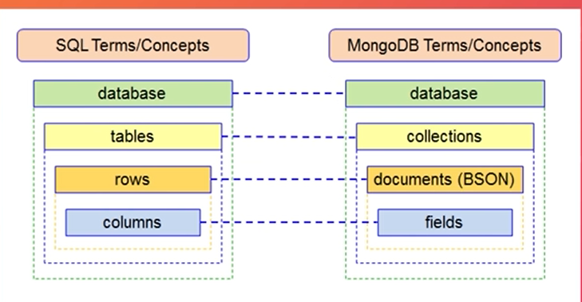

Slide 7
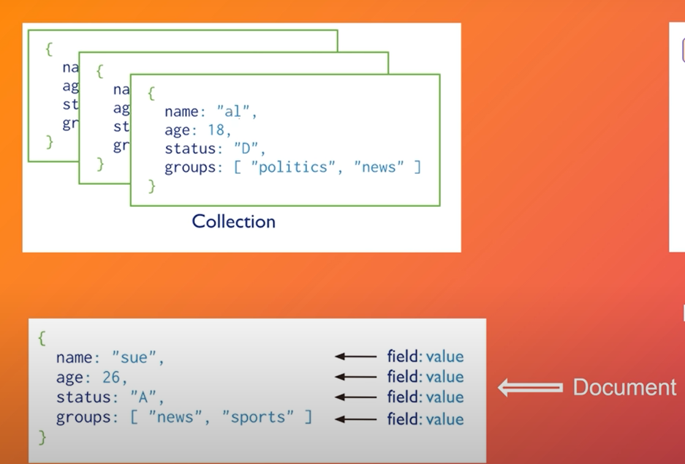

Slide 8
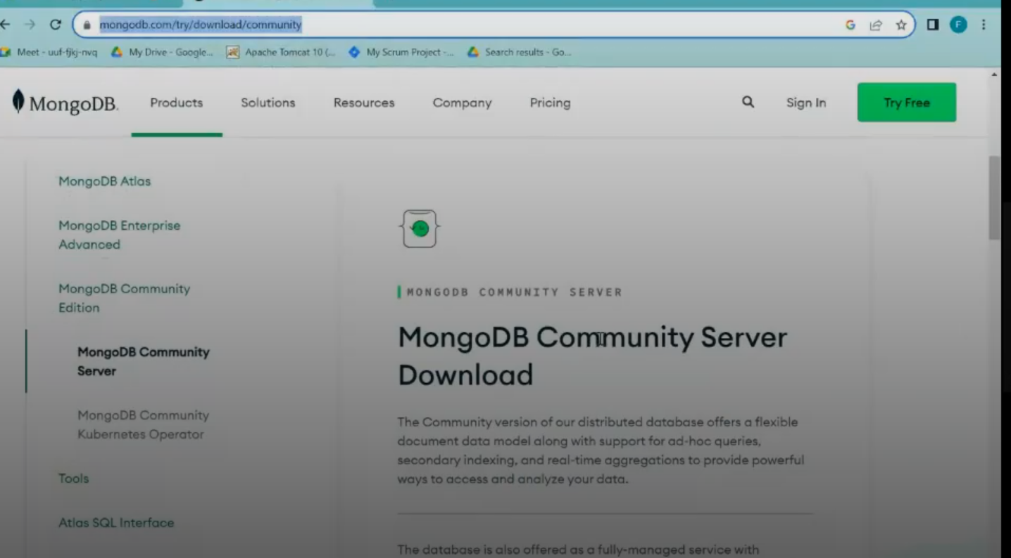

Slide 9
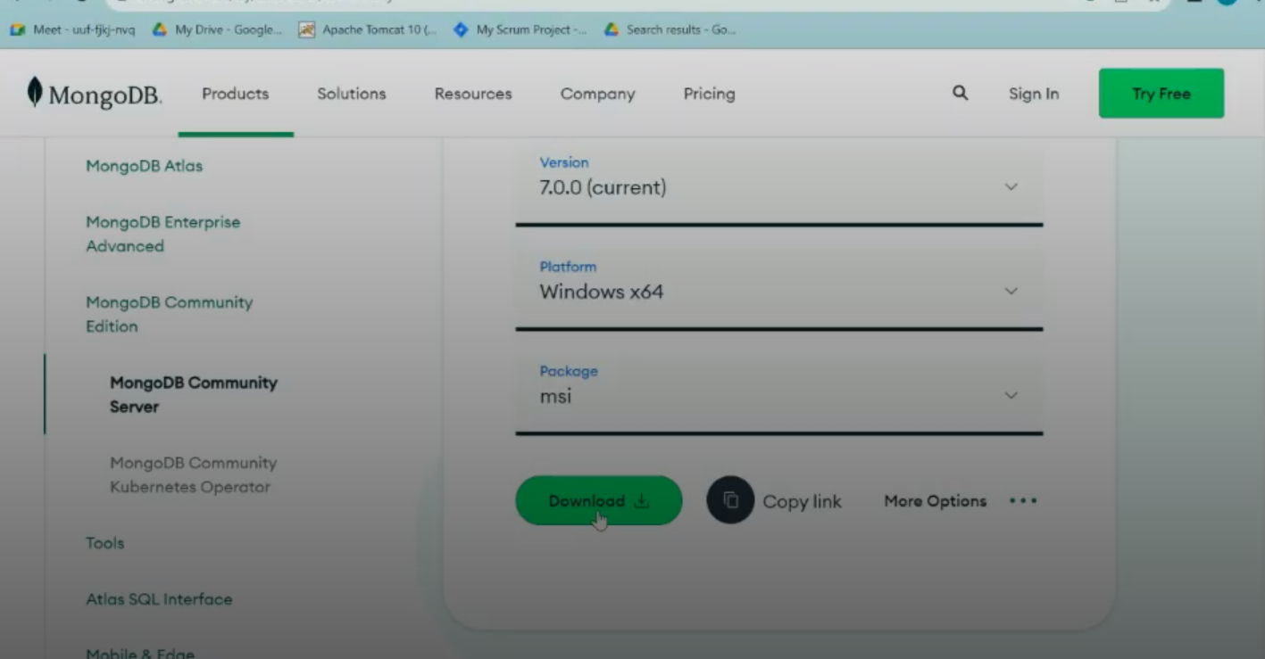
https://www.mongodb.com/try/download/community

Slide 10
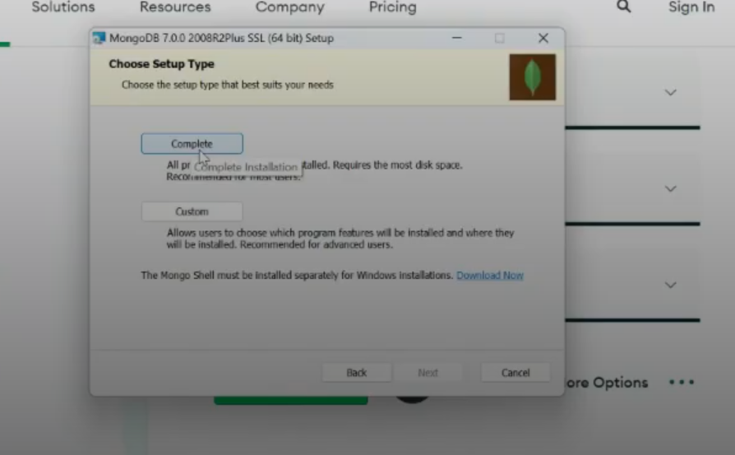

Slide 11
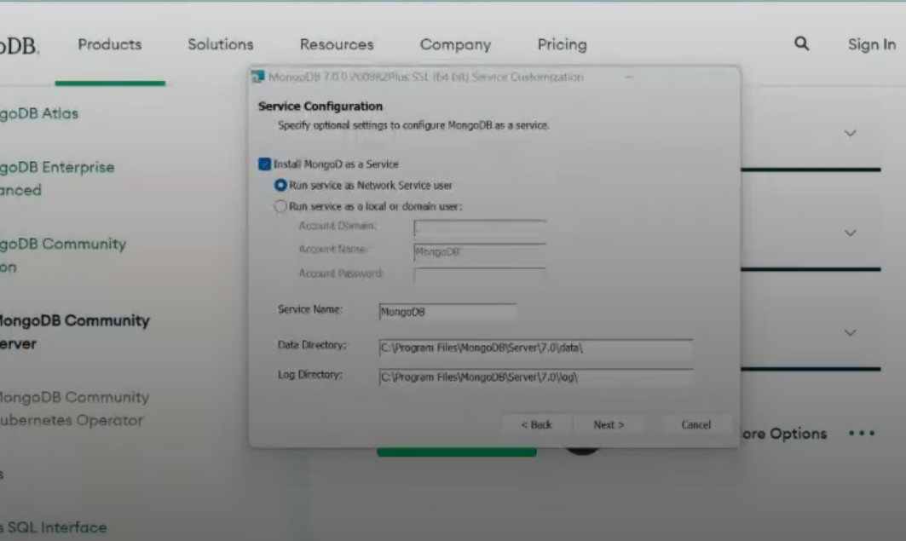

Slide 12
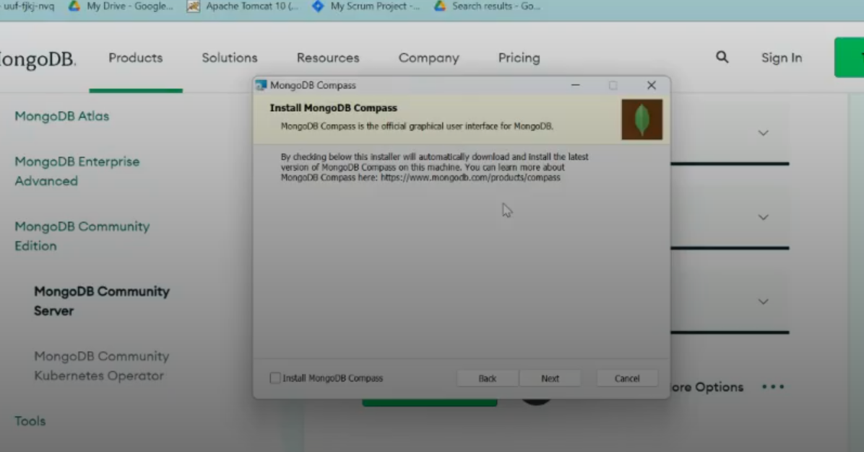
Unchecked it

Slide 13
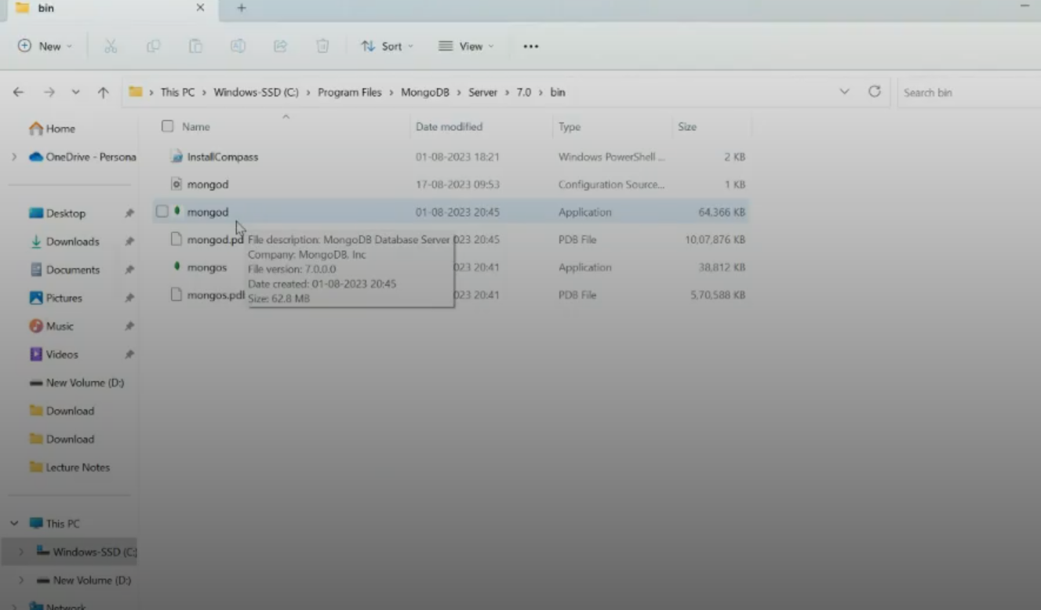

Slide 14
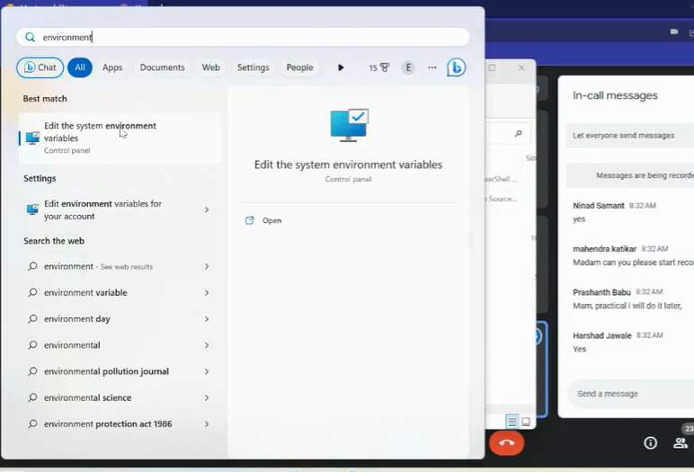
Set the environment variable path
C:\Program Files\MongoDB\Server\8.0\bin

Slide 15
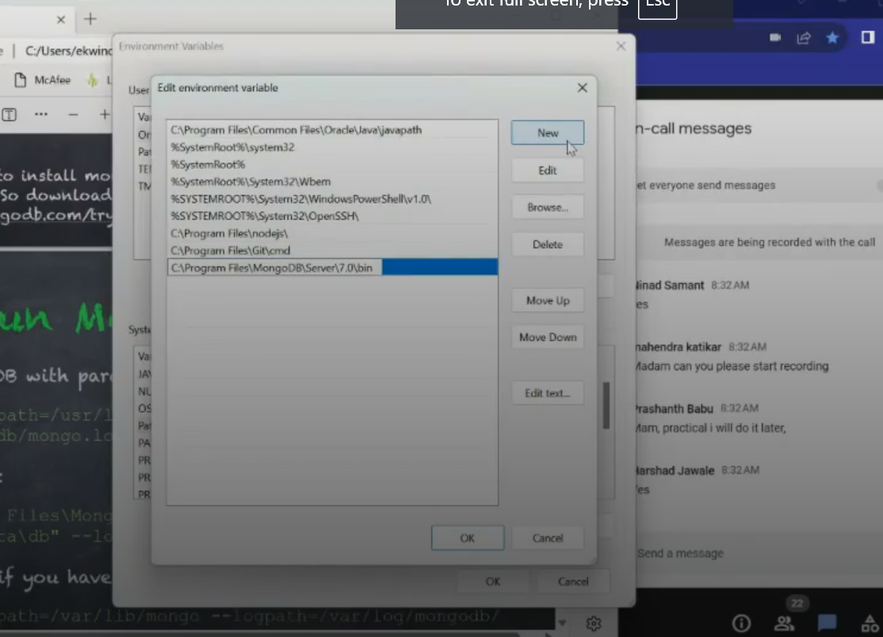
Edit the system variable

Slide 16
Goto cmd →create one folder Mangodb copy path then type this command
C:\Users\hp>mongod --dbpath="C:\Users\hp\Documents\Sonali_mam\MongoDb\data" --logpath="C:\Users\hp\Documents\Sonali_mam\MongoDb"\log\mongo.log"

Slide 17
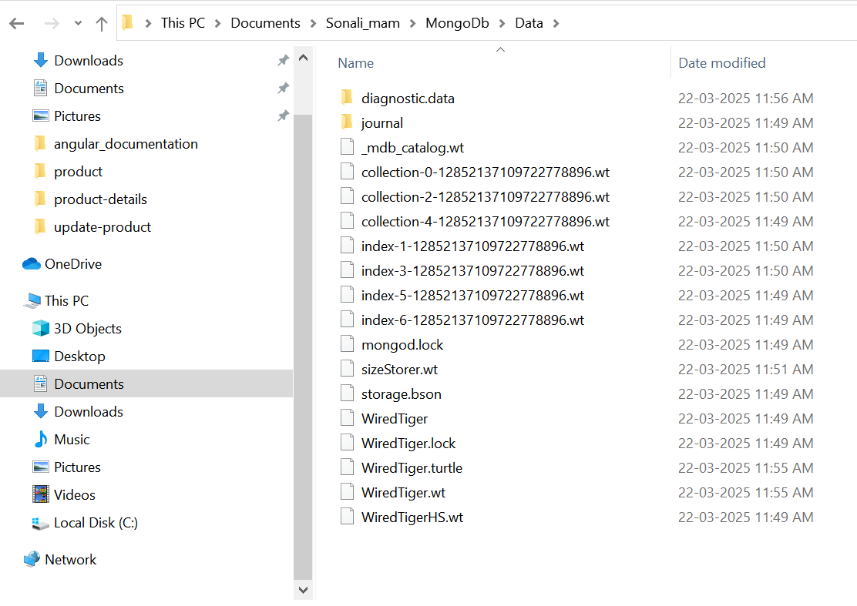
Then it automatically created folder in data and log

Slide 18
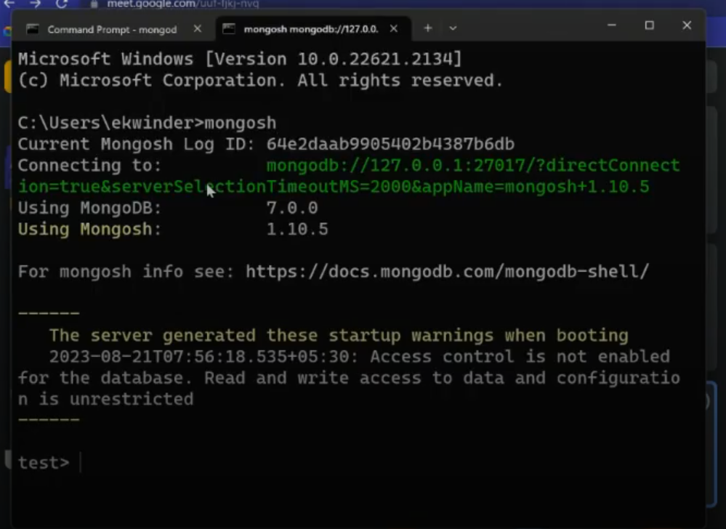
Open new cmd and type mongosh

Slide 19
If it is given error for mongosh then install mongoshell
If you haven't installed it, download MongoDB Shell from the official MongoDB website:
👉 https://www.mongodb.com/try/download/shell

Slide 20
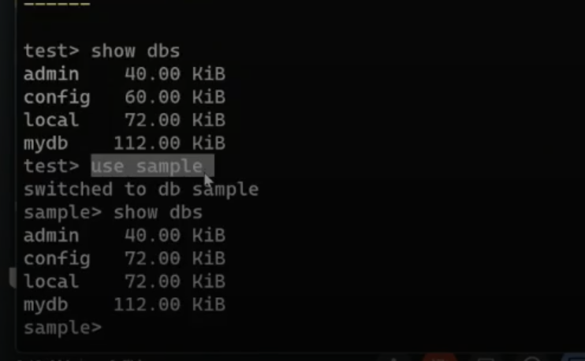
Your own created database name

Slide 21
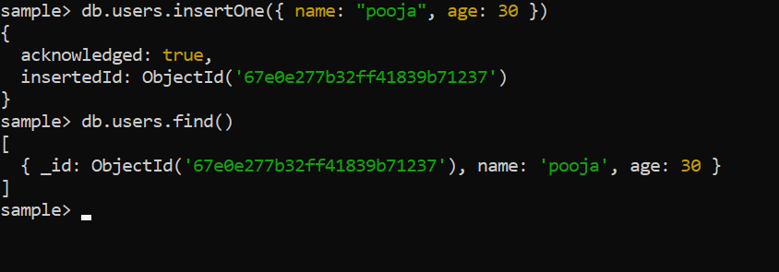
When it check the collection it not showing anything so try to use admin

Slide 22
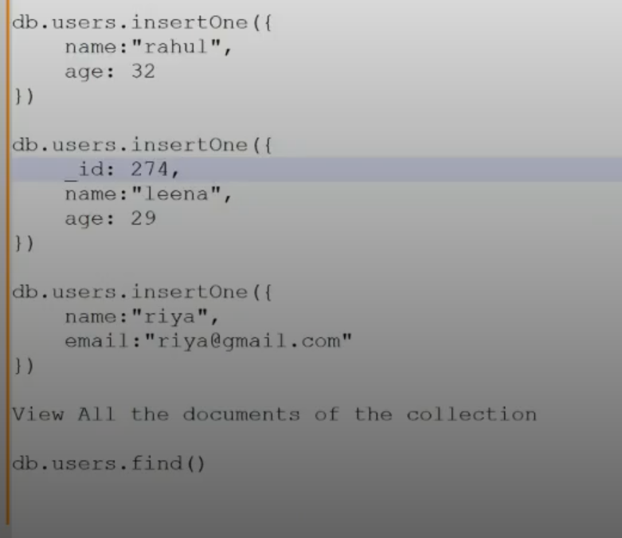

Slide 23
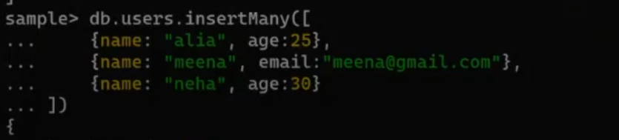
Inserting many records at time

Slide 24
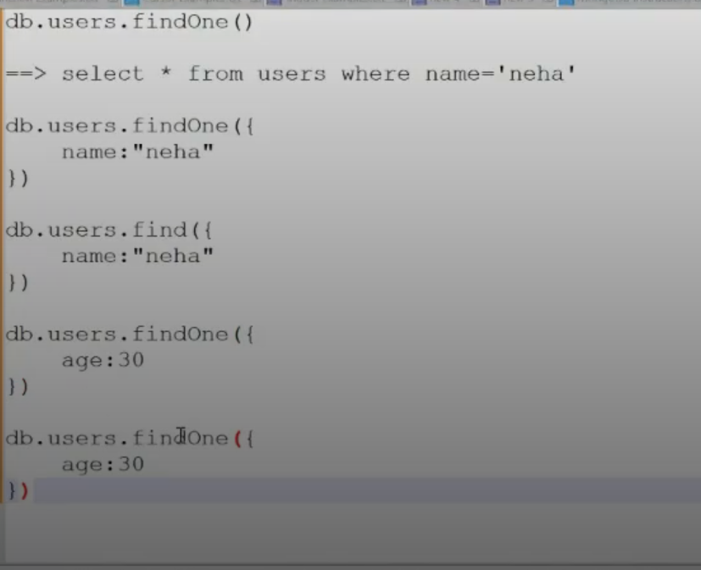

Slide 25
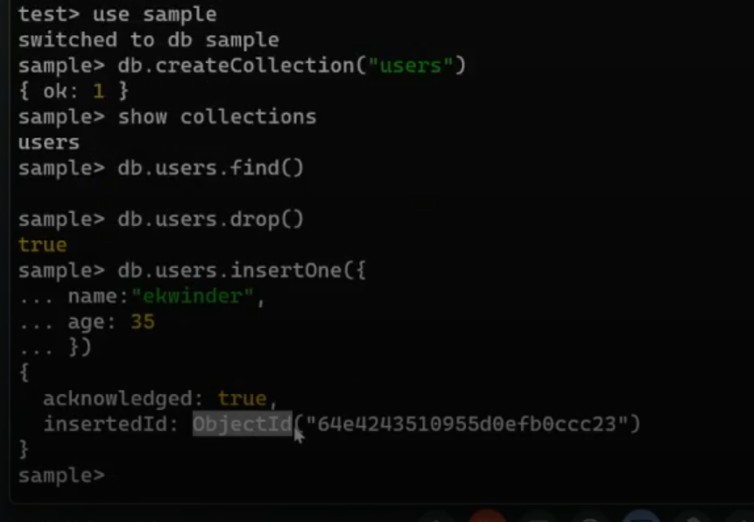

Slide 26
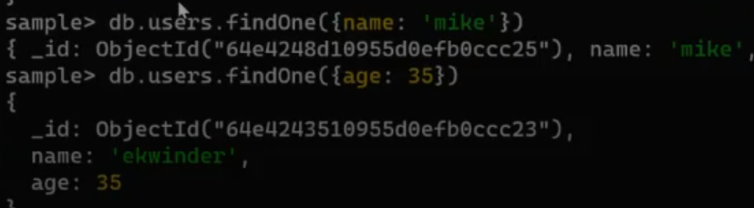

Slide 27
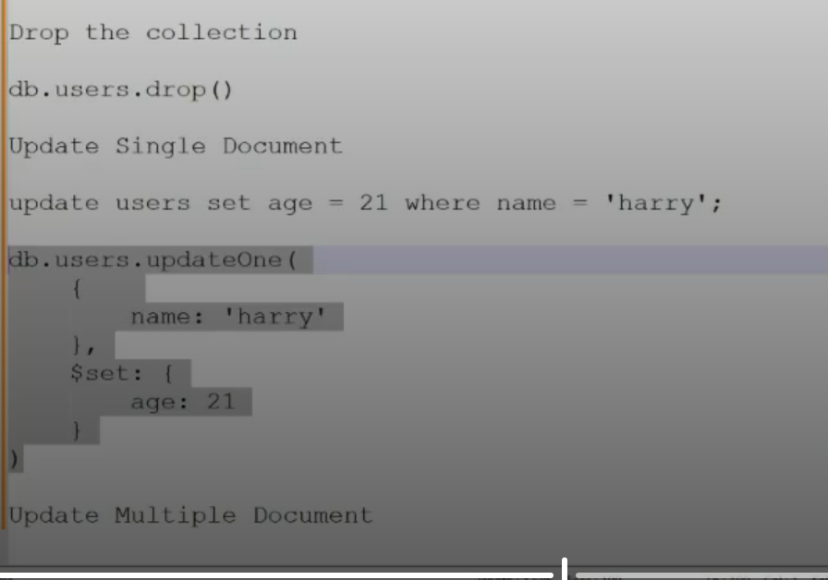

Slide 28
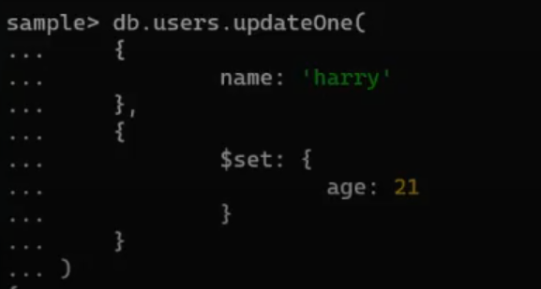

Slide 29
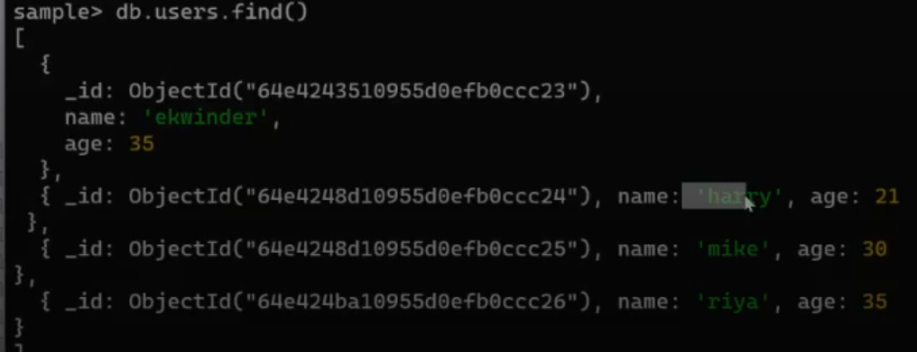

Slide 30
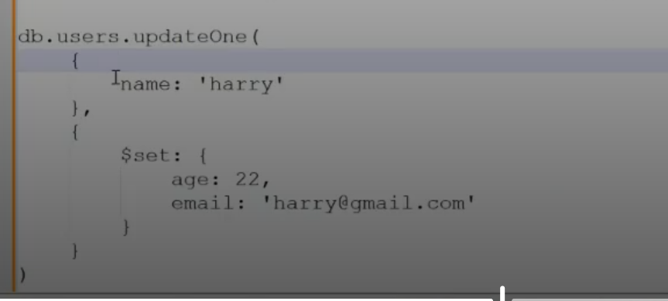
Add email field for updating records

Slide 31
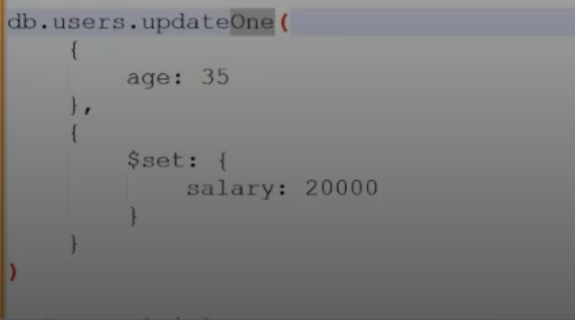

Slide 32
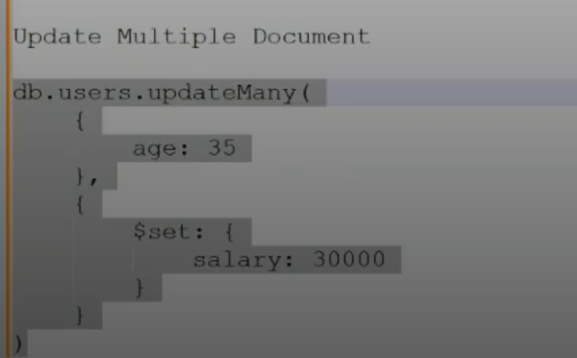
Update many records who having same age

Slide 33
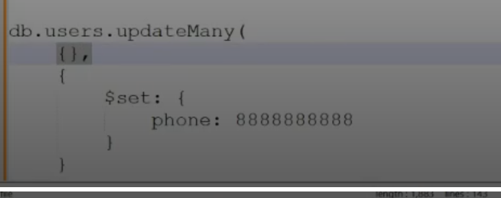
Update many and who having set all salary 888888

Slide 34
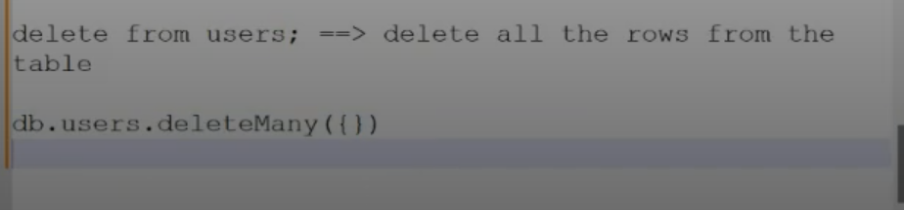

Slide 35
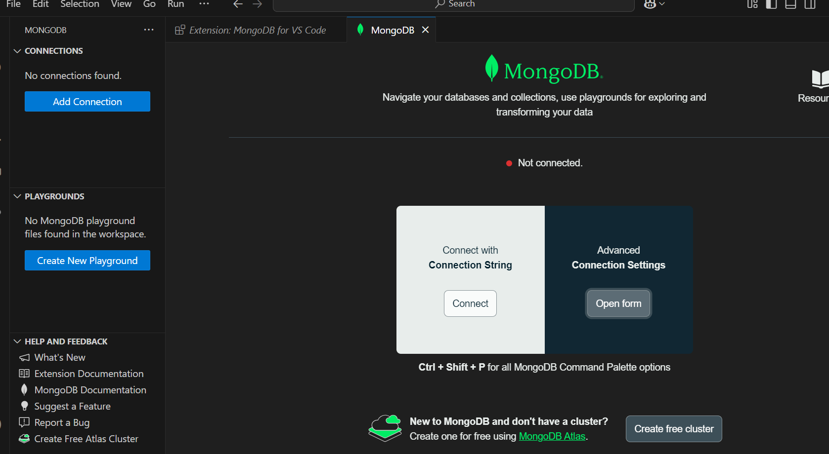

Slide 36
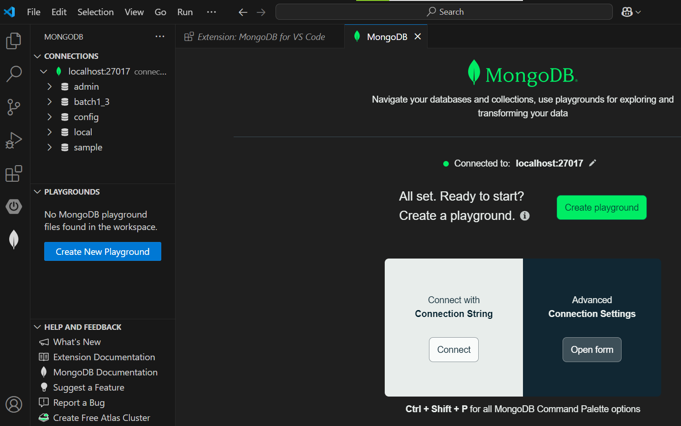

Slide 37
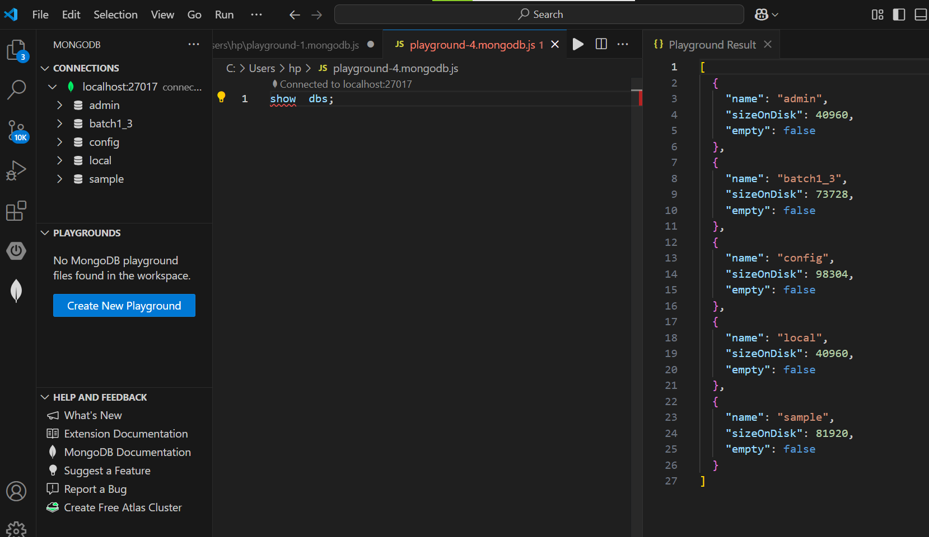
Save this file using .js extension

Slide 38
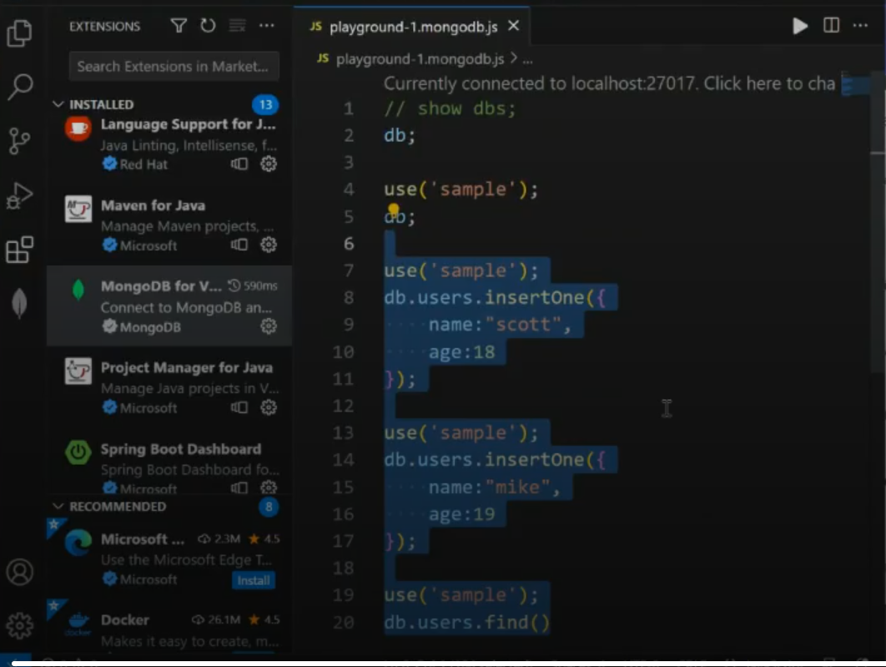

Slide 39
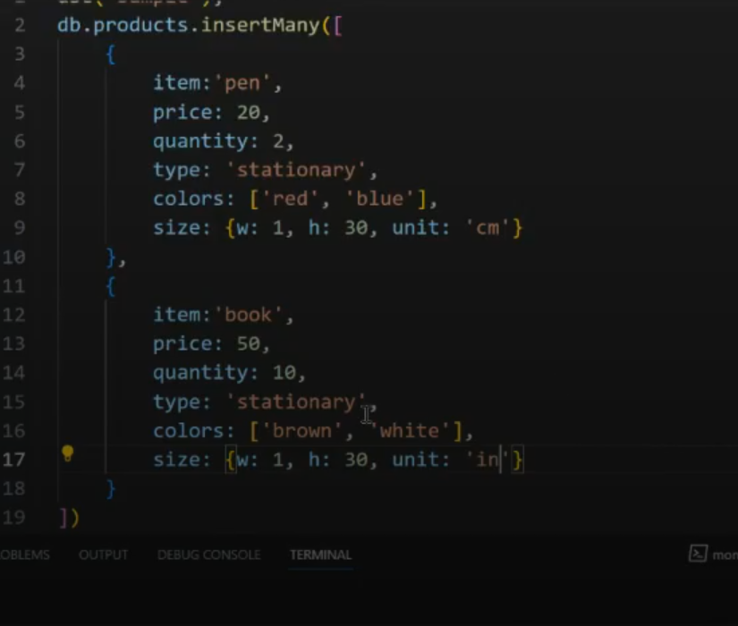

Slide 40
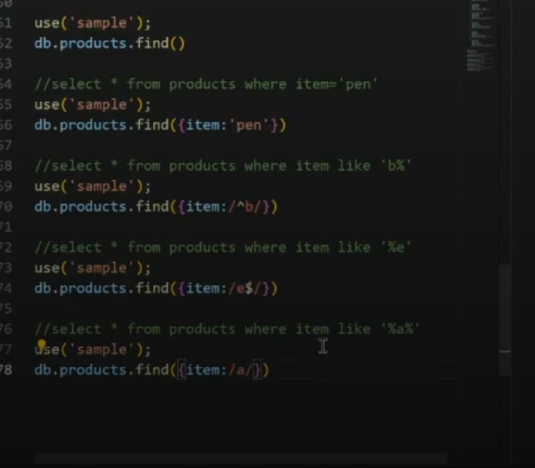

Slide 41
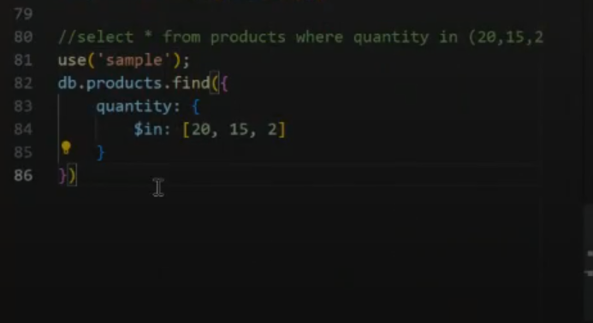
Working with in operator

Slide 42
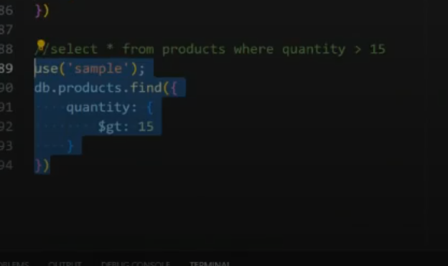
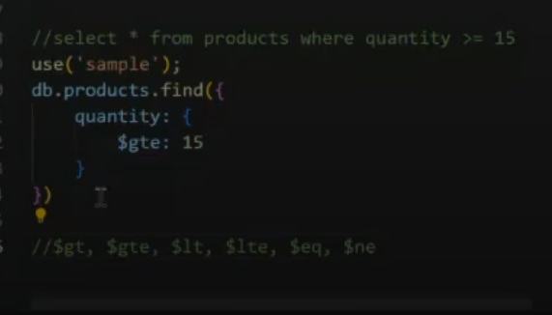

Slide 43
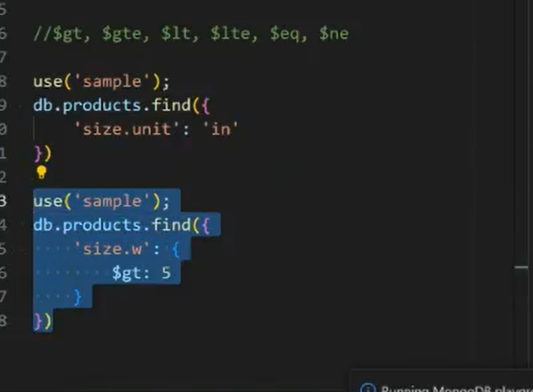

Slide 44
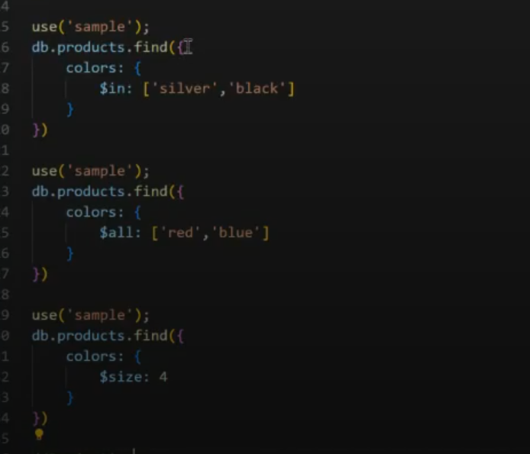

Slide 45
Projections
MongoDB Projection is a special feature allowing you to select only the necessary data rather than selecting the whole set of data from the document. For Example, If a Document contains 10 fields and only 5 fields are to be shown the same can be achieved using the Projections.
Default Behavior: By default, MongoDB queries return all fields in matching documents.
Purpose: Projection is used to restrict the data returned in query results, allowing you to fetch only the necessary fields.

Slide 46
Inclusion: You specify the fields you want to include with a value of 1 (or any non-zero value).
Exclusion: You specify the fields you want to exclude with a value of 0

Slide 47
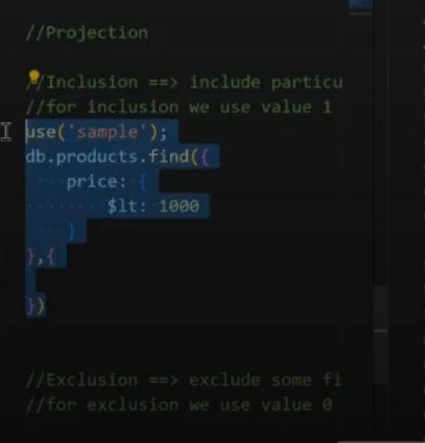

Slide 48
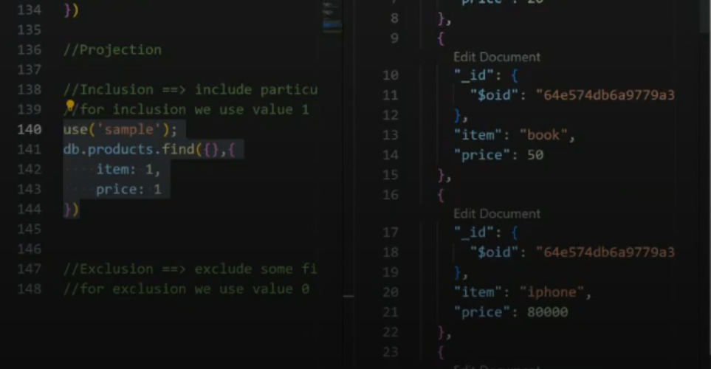

Slide 49
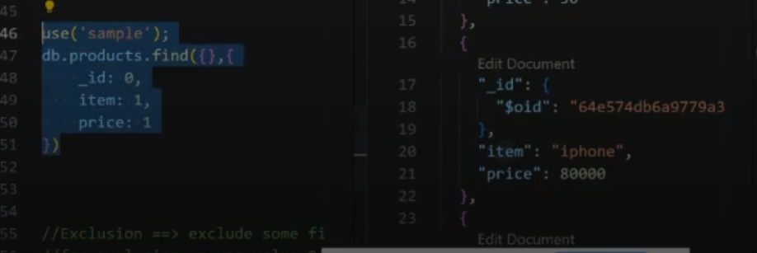
If you dent want to show id

Slide 50
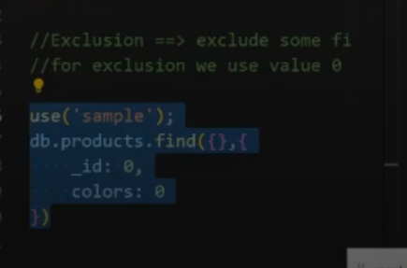
Not Display id and colors

Slide 51
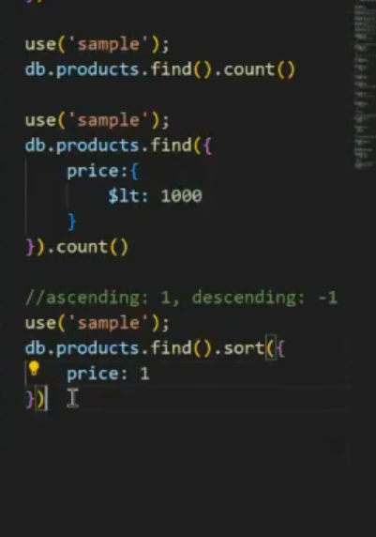

Slide 52
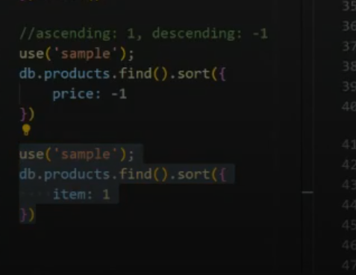

Slide 53
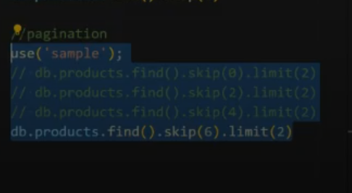

Slide 54
